Slide 1




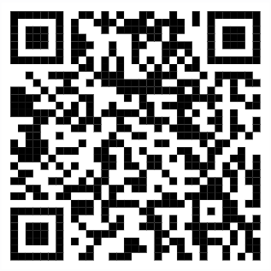
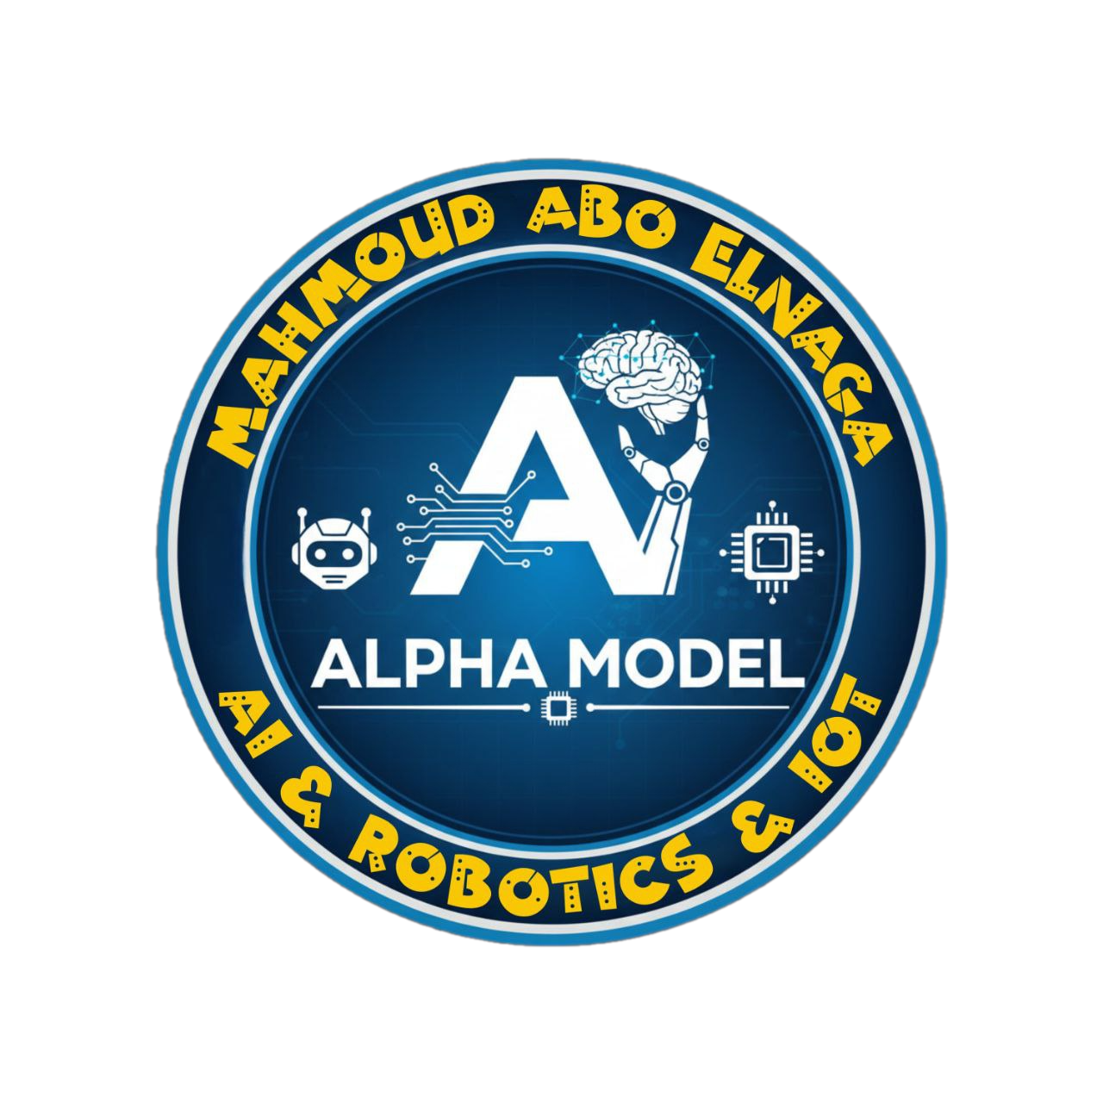

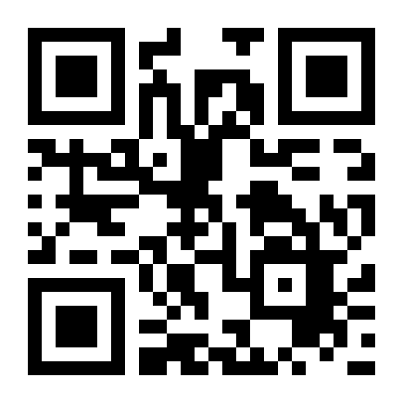
Introduction to Programming and AI Basics
A Foundation for Future Innovators in Robotics and Artificial Intelligence
Prepared for students of the Faculty of Artificial Intelligence at Kafr El-Sheikh University.
Prepared by:
Mahmoud Ayman - Robotics and Artificial Intelligence Major
📧 Email: mahmoudabelnaga11@gmail.com
🔗 GitHub/LinkedIn: mahmoud-abo-elnaga

Slide 2
Lecture (1): Core Concepts and Programming Basics
This lecture covers the fundamental building blocks necessary for any aspiring programmer or AI specialist.
The Fundamentals
1
Programming & Coding Definitions, Languages, and Syntax.
The Tools
2
Understanding IDEs, Editors, Compilers, and Interpreters.
First Steps in Code
3
Exploring Data Types and essential Conditional Statements.
Preparation
4
Tips on choosing the right hardware for your development journey.

Slide 3
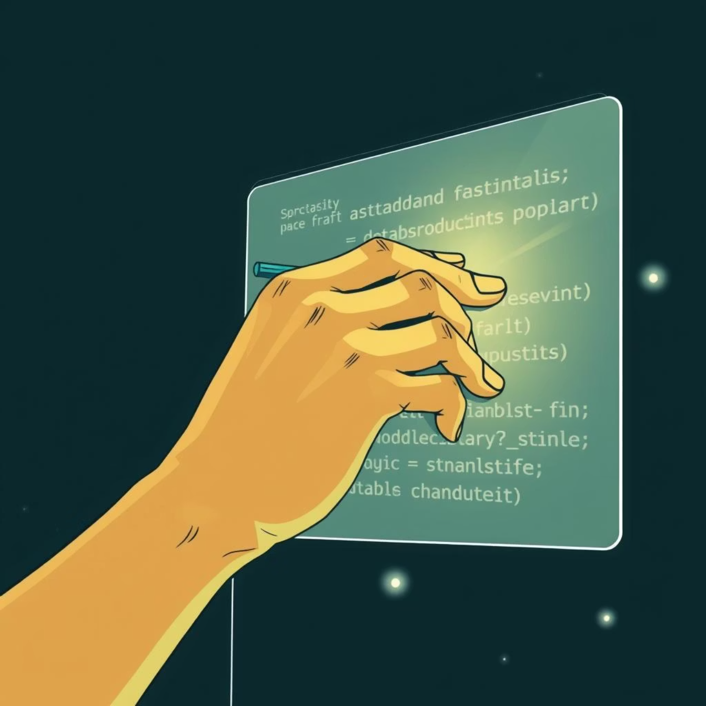
1. The Concept of Programming
Defining the Craft
Programming is the systematic process of providing a computer with a precise sequence of logical instructions, written in a specific language, to execute a task, solve a problem, or build an application.
It is about creating logic that turns input into desired output.
It is the core process behind all software, from mobile apps to AI models.
A Real-World Analogy
Imagine programming a robot: you provide clear, unambiguous steps—"move forward 5 steps," "turn right 90 degrees," "pick up the red block." Programming translates this directive into computer-readable code.

Slide 4



2. What is Coding?
1
2
3
Code is Communication
The Act of Writing
Syntax is Key
Code is the actual text written in a programming language. It is the raw material that communicates instructions to the machine.
Coding is the activity of writing these commands. It requires translating human ideas into a format the computer can parse and execute.
Every programming language requires adherence to a specific set of rules (syntax) to ensure the computer understands the commands.
Coding is the how (the writing), while programming is the what and why (the design and logic).

Slide 5



3. Levels of Programming Languages
Programming languages exist on a spectrum defined by their proximity to machine hardware versus human readability.
High-Level (Python, C++)
Easy for humans to read, write, and maintain. Requires a compiler or interpreter to translate.
Low-Level (Assembly)
Closer to the hardware, offering speed and efficiency, but much harder to write and debug.
Machine Code (0s and 1s)
The native language of the computer's CPU. Extremely difficult for humans to interact with directly.
In AI and Robotics, we primarily use high-level languages like Python for development, which often calls optimized low-level libraries for performance.

Slide 6




4. IDE: Integrated Development Environment
Definition
Key Features
Examples
An IDE is a powerful software application that combines essential development tools into a single, cohesive graphical user interface (GUI).
Source Code Editor (with syntax highlighting)
Popular IDEs include PyCharm (for Python), VS Code (versatile editor/IDE hybrid), and Arduino IDE (for embedded systems).
Build automation tools (compiling/interpreting)
Debugger (for finding and fixing errors)
Using an IDE significantly boosts productivity by streamlining the entire code-write-debug-run cycle.

Slide 7


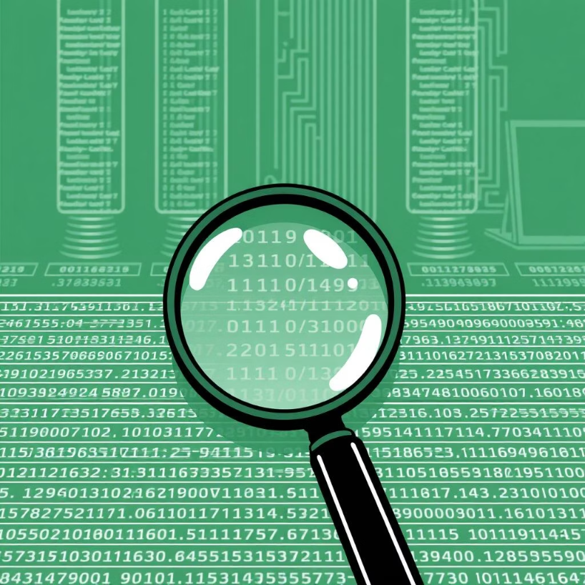

5. Understanding Code Syntax
The Grammar of Code
Python Example:
Syntax refers to the mandatory rules and structure of a language. If code violates the syntax, the program cannot compile or execute—it results in a 'Syntax Error'.
if x > 0: print("Positive number")
In Python, the colon (:) and the required indentation define the block of code to execute under the condition.
Punctuation
Structure
Correct use of commas, semicolons, and brackets (e.g., in C++).
Proper indentation and block structure (critical in Python).
Keywords
Using reserved words (like if, while, def) correctly.

Slide 8
6. Code Processing Pipeline: Editor, Compiler, Interpreter
These are the three main tools that turn human-written source code into executable machine code.
Editor
A simple text-only tool (like Notepad++) used only for writing and modifying code files.
Compiler
Translates the entire source code into machine language at once, creating a standalone executable file (e.g., C, C++).
Interpreter
Executes code line-by-line, translating and running as it goes. If an error is found, it stops at that line (e.g., Python).

Slide 9
7. Data Types: Organizing Information
Data types are classifications that define the kind of data a variable can hold and the operations that can be performed on it.
Type
Description
Example
int
Integer numbers (whole numbers without decimals).
age = 20
float
Floating-point numbers (numbers with a decimal point).
pi = 3.14
string
Textual data, represented as a sequence of characters.
name = "Mahmoud"
bool
Boolean values: the logical states of True or False.
is_ai = True

Slide 10




8. Conditional Statements (If-Else)
Conditional statements are control flow tools that allow the program to execute different blocks of code based on whether a specified condition evaluates to True or False.
Condition Check
If True (Action 1)
If False (Action 2)
The program evaluates the expression inside the if statement (e.g., distance < 10).
The code block immediately following the if statement is executed.
The code block following the else statement is executed instead.
Python Example:
if distance < 10: print("Stop")else: print("Move Forward")
In robotics, this logic is fundamental for navigation, obstacle avoidance, and decision-making processes.

Slide 11
Task
What is Programming?
What is Coding?
Types of Programming Languages
High-Level Languages
Low-Level Languages
Machine Code
General-Purpose vs Domain-Specific Languages
IDE (Integrated Development Environment)
Syntax
Difference Between Editor, Compiler, and Interpreter
Data Types
Conditional Statements (If–Else)
How to Choose a Laptop for Programming

Slide 12
Thank you

